Slide 1
Streamlining Service Request Dispatches using Neural Networks
Kiruthika Varatharajan
Subash Shankar

Slide 2
Problem Statement
Everyday, hundreds of service request dispatches are being scheduled by broadband companies depending upon the issue raised by the customer.
In the telecommunication world, a dispatch usually means the process between attending a call for a service request from a customer, analyzing the issue and then assigning it to a technician.
While analyzing historical data, we found that over 50% of the dispatch calls can be solved remotely or the issue could be because of some external factors which gets solved by itself overtime.

Slide 3
Benefits
The broadband company spends a lot of money scheduling these dispatch requests. And when a dispatch gets cancelled the company loses a lot of money.
The neural network model is learning to decide whether a dispatch would be required for this particular issue based on the available metrics.
So, it is important to build a model that can detect these unwanted dispatches and in turn save millions of dollars for the company.

Slide 4
Performance Metrics
We are calculating the performance metrics using model accuracy and number of False Positives in the confusion matrix.

Slide 5
How did we solve it?
We used two datasets. One has the required line metrics and other has the cancelled and non-cancelled dispatch data.
Initial data preprocessing and cleaning was performed
Converted the dataset into two-time frames AM and PM and grouped the data.
The labelling is done using cancelled and non-cancelled dispatch data.
The dataset has been split into train-test data and fed it to the model.

Slide 6
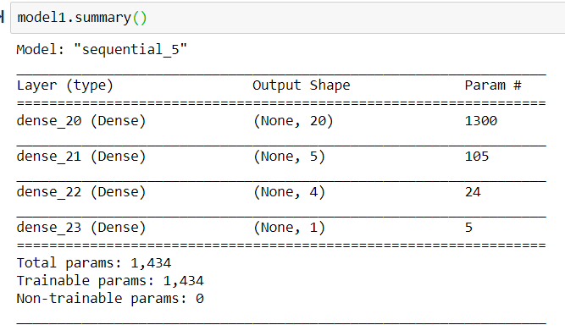
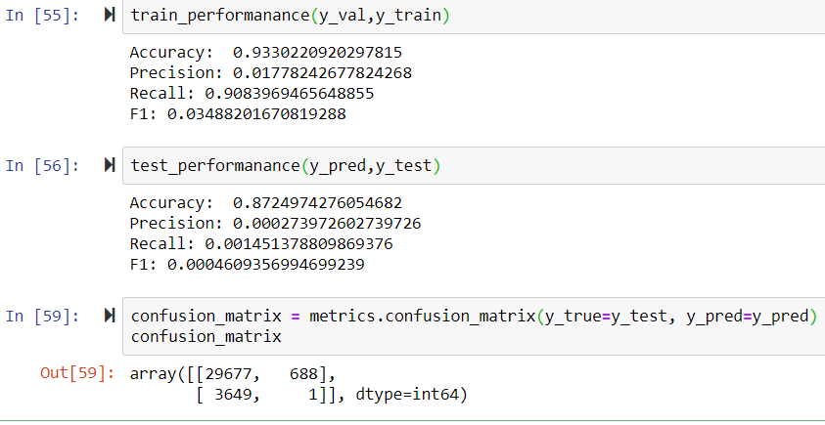
Results

Slide 7
Conclusion and Limitations
We got a test accuracy of 87 % so, the model was able to correctly predict whether dispatch would be required or not.
We learned data preprocessing, data cleaning and how to use neural networks to train the model.
Lack of elaborate knowledge in networking concepts and we do not have a well-balanced dataset, the dataset is poorly distributed, and we can clearly see some overlapping between the two datasets so, mis classification is occurring during prediction.

Slide 8
Future Work
We plan to add more features like weather patterns and other external factors that may influence the model to make better predictions.

Slide 9
Thank You
Questions???

